Slide 1
IBM Maximo Application Suite Solution Guidance
IBM Confidential - For Internal Use Only
Updated: July 2023
Narendra Rachapalli
Joe Kiernan
Satish Narasimha
Satyapramod Dambal
Megha Jingar
Pradeep Lamba
Jose Ocasio
Ashok Iyengar
Contribution and Guidance:
Changwoo Jung
Ron Baker
Jenny Wang
Avinash Mane
Subash Srikantiah

Slide 2
Topics
Overview – Solution Guidance Overview
Value Proposition – IBM Maximo Application Suite (MAS) Overview and Deployment Options
How to Solution MAS – Details of various aspects to consider when solutioning MAS
Migration – Maximo 7.x to MAS 8.x
Delivery – Delivery Model / RACI / ROI
Customer References – Examples of Client Use Cases
Supporting Information – References and FAQs

Slide 3

Solution Guidance Overview

Slide 4
Solution Guidance Overview
This presentation provides solution guidance for solutions to be implemented for asset management requirements using Maximo Application Suite (MAS) of product offerings.
Key areas addressed are:
MAS Offering Overview along with architectural components
Deployment Architecture based on non-functional requirements
Architectural Decisions
Services solution with Responsibility Mapping
IBM Maximo Application Suite v8.x is the primary focus and most relevant to Maximo Manage.
This asset can be used as a solution guide by solutioners
When MAS is selected and to be deployed as a self managed option (software)
When customer is moving from Maximo 7.x to MAS 8.x

Slide 5
Solution Summary: Aspects & Domains
Aspects | Domains
Application | Data and AI | Edge | Blockchain | Mobile | Business Automation | Enterprise Applications*
Data | Integration | Governance | Analytics | Databases | Reporting & Visualization
Compute | Bare Metal Servers | Virtual Servers | Virtualization | Containers | Serverless | Cloud Foundry
Storage | Primary Storage | Backup | Archive | Data Migration
Networking | Enterprise Connectivity | Segmentation | Cloud Connectivity | Load Balancing | Content Delivery Network (CDN) | Domain Network Services (DNS)
Security | Data Security | Identity & Access Management | Application Security | Infrastructure and Endpoint | Threat Detection and Response | Governance, Risk & Compliance
DevOps | Build & Test | Delivery Pipeline | Code Repository
Resiliency | Backup | Disaster Recovery | High Availability
Service Management | Monitoring | Logging | Auditing / Tracking | Alerting | Event Management | Management/ Orchestration
 | Domains Taxonomy from Architecture Framework
 | Domains considered in solution to address customer requirements

Slide 6
MAS Overview and Deployment Options
MAS Deployment - Solutioning Guide | IBM Confidential | IBM Cloud Solutioning Centers

Slide 7
IBM Maximo Application Suite
IBM MAS is a collection of applications, industry solutions, add-ons, and tools to build powerful AI-driven asset and analytics solutions for enterprise needs. IBM MAS is offered as a customer-managed product on Red Hat OpenShift and also as an IBM Managed Service.
Applications included as part of MAS:
IBM Maximo Manage
Maximo Manage is an asset lifecycle and workflow process management application that manages asset operations and business processes and integrates existing enterprise applications. It delivers a comprehensive view of all asset types, their conditions and locations, and the work processes that support them, providing optimal planning, control, audit, and compliance capability.
IBM Maximo Monitor
Maximo Monitor provides a monitoring solution for real-time visibility, root-cause troubleshooting, anomaly detection, and AI-driven alerts at scale.
IBM Maximo Health
Maximo Health helps consolidate operation, asset, and maintenance data to gain insight into asset performance and to optimize preventive maintenance and replacement planning. Clients can increase trust in data by reviewing assets that have potential data quality issues, and can configure asset scores to drive efficiency, optimize costs, and reduce risk.
IBM Maximo Predict
Maximo Predict uses historical and real-time asset performance data, maintenance records, inspection reports, and environmental data to correlate performance factors that predict asset degradation or failure. Maximo Predict uses artificial intelligence to optimize and predict model accuracy.
IBM Maximo Visual Inspection
It is a video and image analysis platform built on cognitive infrastructure. The platform offers built-in deep learning models that learn to analyze images and video streams for classification, object detection, and anomaly detection.
Notes:
Maximo was an IBM Acquisition in 2006. Current version of Maximo Application Suite as its called now is 8.10.x. 8.x version of Maximo is a complete new architecture built on Redhat OpenShift released in June 2020. Hence this is a continuous delivery-based product and we keep getting new versions every quarter. Last Version of traditional Maximo EAM was 7.6.x.
Roughly there are approx. 3000+ installs of Maximo and from a service perse, there are lots of implementation partners. IBM Consulting has a strong presence of implementation experience, and the team is part of FSCT (Finance and Supply Chain Transformation) Service Line under BTS Growth Platform.
Post Covid, there has been a consistent uptick in APAC for greenfield implementations of MAS 8.x based solutions. Similar trend now has started in EMEA and Americas. Hence we are now curating a prescriptive solution guidance for all the CSLs based on the learnings from many deals we have solutioned so far.

Slide 8
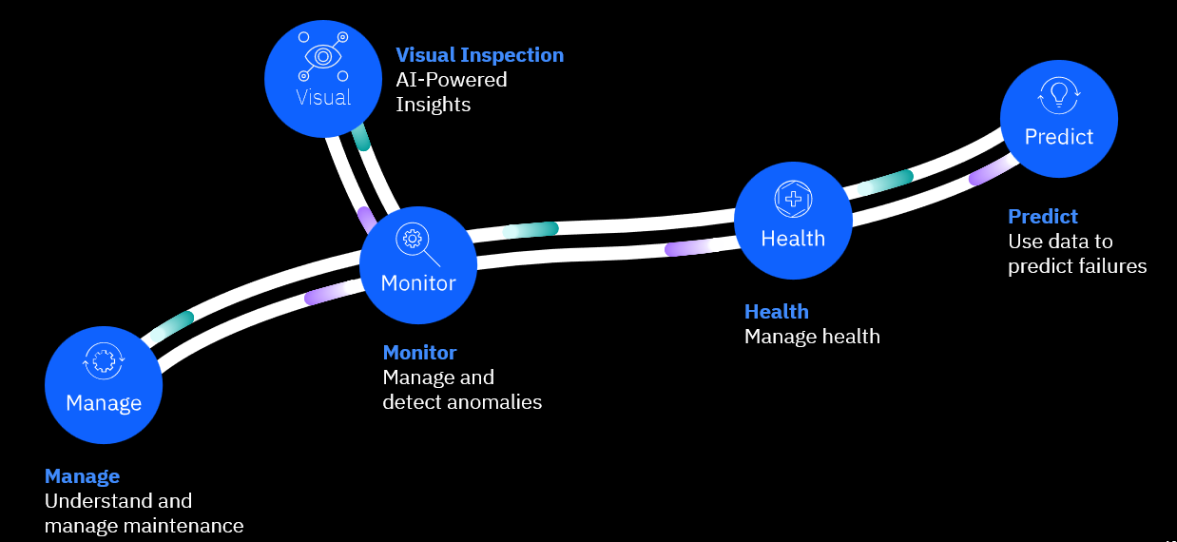
IBM Maximo Application Suite – Client Maturity Model
An Asset Management Maturity model is used to describe where a company is in relation to the top performing enterprises. As organizations mature, maintenance then shifts from being viewed as a necessary expense through to an investment which creates business value.
As clients move from the bottom left to top right, overall maintenance costs can be reduced but the value to the organization as a whole increases as assets become more reliable, downtime is reduced and asset performance is increased.
The Asset Management Maturity Model displayed here has 4+ levels, and client starting off point may not be at the beginning. Moving through to successive levels in the maturity model will take time and effort and a commitment from all stakeholders. Additionally, not all assets are the same, for some it will be quite acceptable to replace them when they have broken, for others we might listen to the assets for audible or inaudible changes in order to predict future failure.

Slide 9
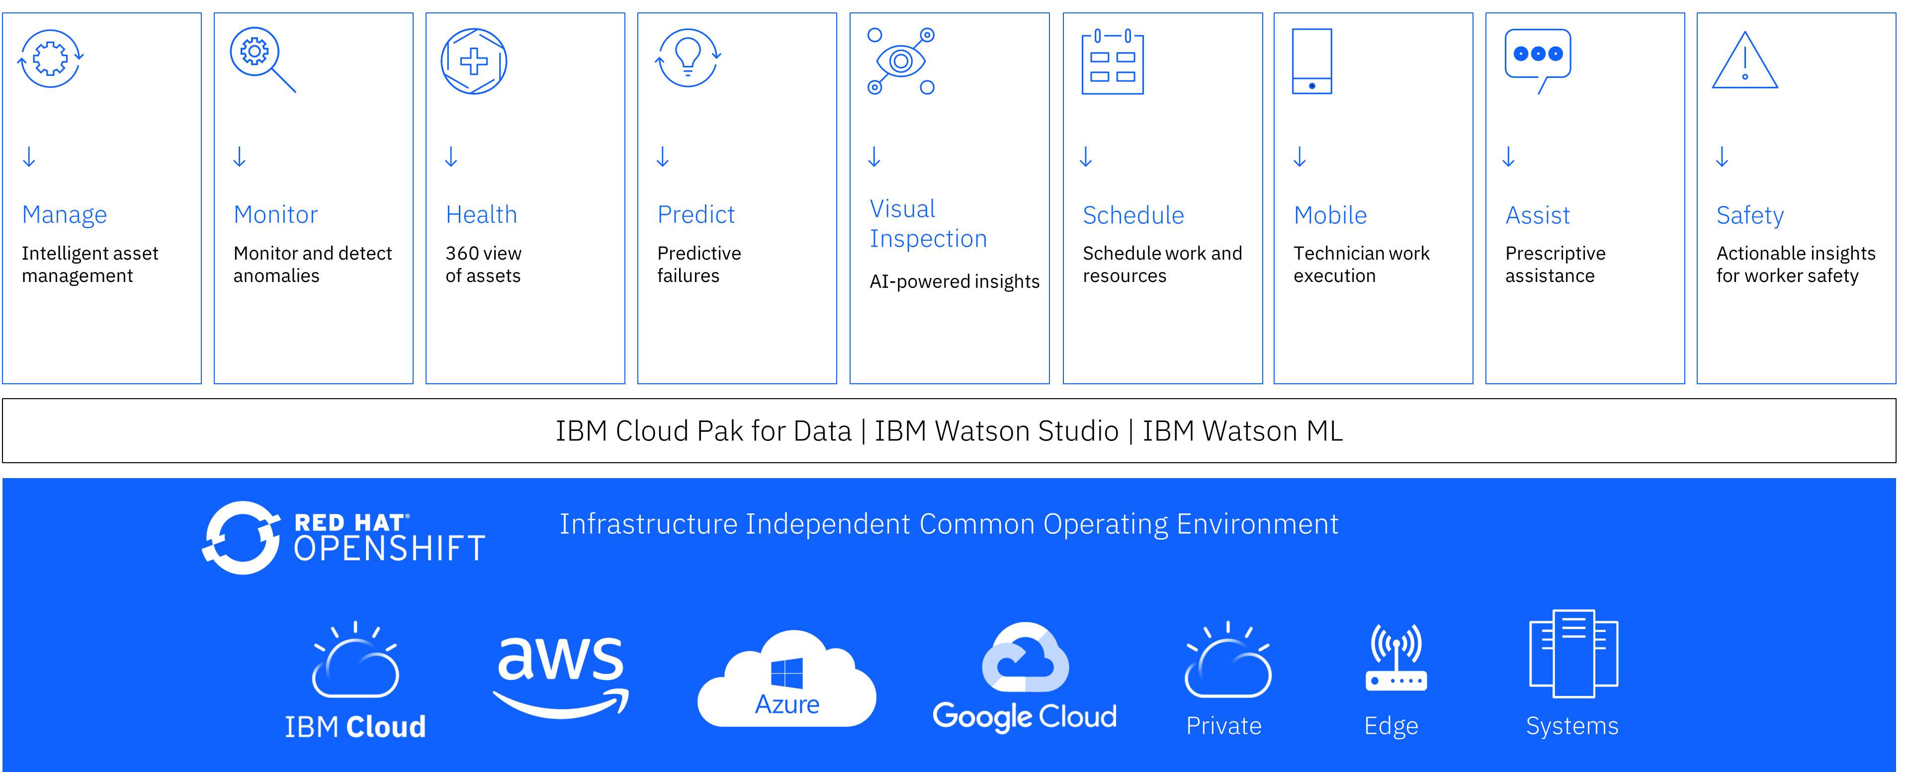

Maximo Application Suite
Multi-Cloud Deployment

Slide 10
Maximo Application Suite - Catalog
MAS Applications
Manage
Monitor
Health
Predict
Visual Inspection
Assist
Safety
MAS Industry Solutions
Manage
Transportation
Manage
Nuclear
Manage
Utilities
Manage
Oil & Gas
Manage
Aviation
Manage Civil Infrastructure
Health & Predict Utilities
MAS Add-on Solutions
Manage Asset Configuration
Manager
Manage
Health, Safety & Environment
Manage
Service Provider
Manage
Maximo Mobile
Anywhere
Manage
Spatial
Manage
ERP Connector
for SAP
Manage
ERP Connector
for Oracle
MAS Add-on Parts (Separate Product IDs)
Manage
Transportation
Manage
Nuclear
Manage
Utilities
Integrations
Maximo
Scheduler Optimization
Maximo
MRO Inventory Optimization
IBM
Digital Twin Exchange
Notes:
It is also important to understand that Maximo Manage is essentially a ‘suite within a suite’. This slide shows all the applications clients have access to through Maximo Application Suite (MAS).
NOTE: The MAS Add-On Parts are a separate product IDs (PID) and must be procured separately if used within MAS. These are integrated solutions, with separate commercial requirements based on third-party royalty agreements.

Slide 11
MAS Deployment Options
Customer managed
IBM managed
Deployment | Procure | Provision & Operate | Client Benefits
On Premises Customer Managed | Client purchases MAS from IBM Client provides infrastructure | Client provisions, manages, and operates full stack | Maximum operational flexibility
Hyperscalers Customer Managed | BYOL Client purchases software from IBM and infrastructure from hyperscalers | Client runs IBM-provided automation scripts to deploy MAS on hyperscalers’ cloud Client manages and operates both software and infrastructure | Simplifies procurement and deployment Allows client to select their hyperscaler Flexibility for clients to manage and operate their environment
 | Paid (Marketplace listing) Client purchases software and infrastructure from hyperscalers
SaaS IBM Managed | Client purchases single part (includes software, infrastructure, and operations) from either IBM or AWS Marketplace | IBM provisions, manages, and operates client’s MAS environment on AWS Cloud using IBM’s AWS cloud account | Reduced time-to-value Reduced operational costs Allows clients to focus on business priorities
Dedicated (Managed Service) IBM Managed | Client purchases software and managed service (including infrastructure) from IBM or AWS Marketplace (Private offering) | IBM provisions, manages, and operates client’s MAS environment on IBM Cloud or AWS in an IBM owned account | Simplifies deployment and operations Provides more flexibility, than SaaS, to customize environment Provides more operational flexibility than SaaS

Slide 12
MAS Solutioning Decision Tree
Start
New MAS 8.x install
N
Move Maximo 7.x to MAS 8.x*
Number of environments
Database migration
N
MAS Migration
Y
Y
DB Migration**
Data residency requirement
Client prefers non IBM Cloud or on-prem
>99.9% SLA required
Flexibility to customize
N
N
N
N
MAS SaaS
Y
Y
Y
Y
MAS Software
MAS SaaS Dedicated
Deployment Options
Deployment Options
HA MZR
HA multi-region
AWS
IBM Cloud
Azure (TBD)*

Slide 13
MAS Managed Service v/s Software – An Overview
IBM Maximo Application Suite
Maximo Application Suite Managed Service
An offering supported by IBM's Cloud Delivery Services and Development Operations team
Supports BYOL or license subscription can be bundled as part of Managed Services for MAS license subscriptions
Leverages IBM Cloud Platform Services and offered on a shared infrastructure. Client instances are isolated by namespaces.
Supports 99.9% SLA Availability for Production Environments
Available on most of the IBM Cloud MZR data center locations
Supports site-to-site IPSec VPN
Supports only DB2 as the MAS database
Prior subscription is required and not offered as a “pay as you go” model”
SaaS has tighter restrictions around security,database access, upgrade schedules
SaaS is focused on a standard implementation across the entire offering, allowing for greater automation and easier operation
SaaS uses shared AWS services (although each client will have their own instance of the application and database)
IBM Maximo Application Suite (Software)
IBM Maximo Application Suite multi-cloud software through Red Hat OpenShift
Self Managed
Deploy anywhere and on any cloud including customer’s datacenters
Supports DB2, Oracle and MS SQL Databases
Can be deployed as per client’s Functional and Non-Functional requirements such as Compliance, HA, DR, Availability SLAs, etc.
PID 5900-AMG: IBM Maximo Application Suite as a Service

Slide 14
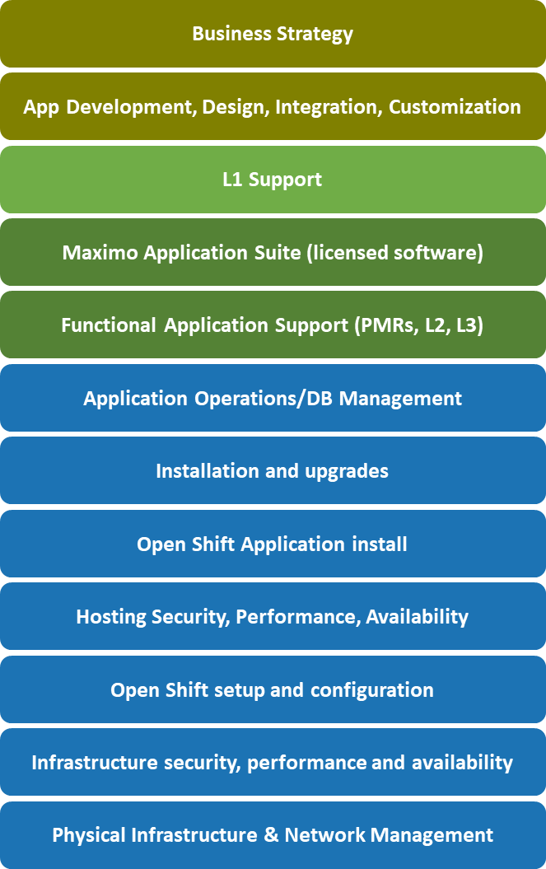
IBM Managed Offerings : MAS
MAS Dedicated or SaaS operates the complete stack
x
License or subscription
Purchasing infrastructure from Cloud providers only covers the IaaS below. Initial set up takes you to PaaS.
MAS
SaaS
MAS
Dedicated
Platform as a Service (PaaS)
Infrastructure as a Service (IaaS)

Slide 15
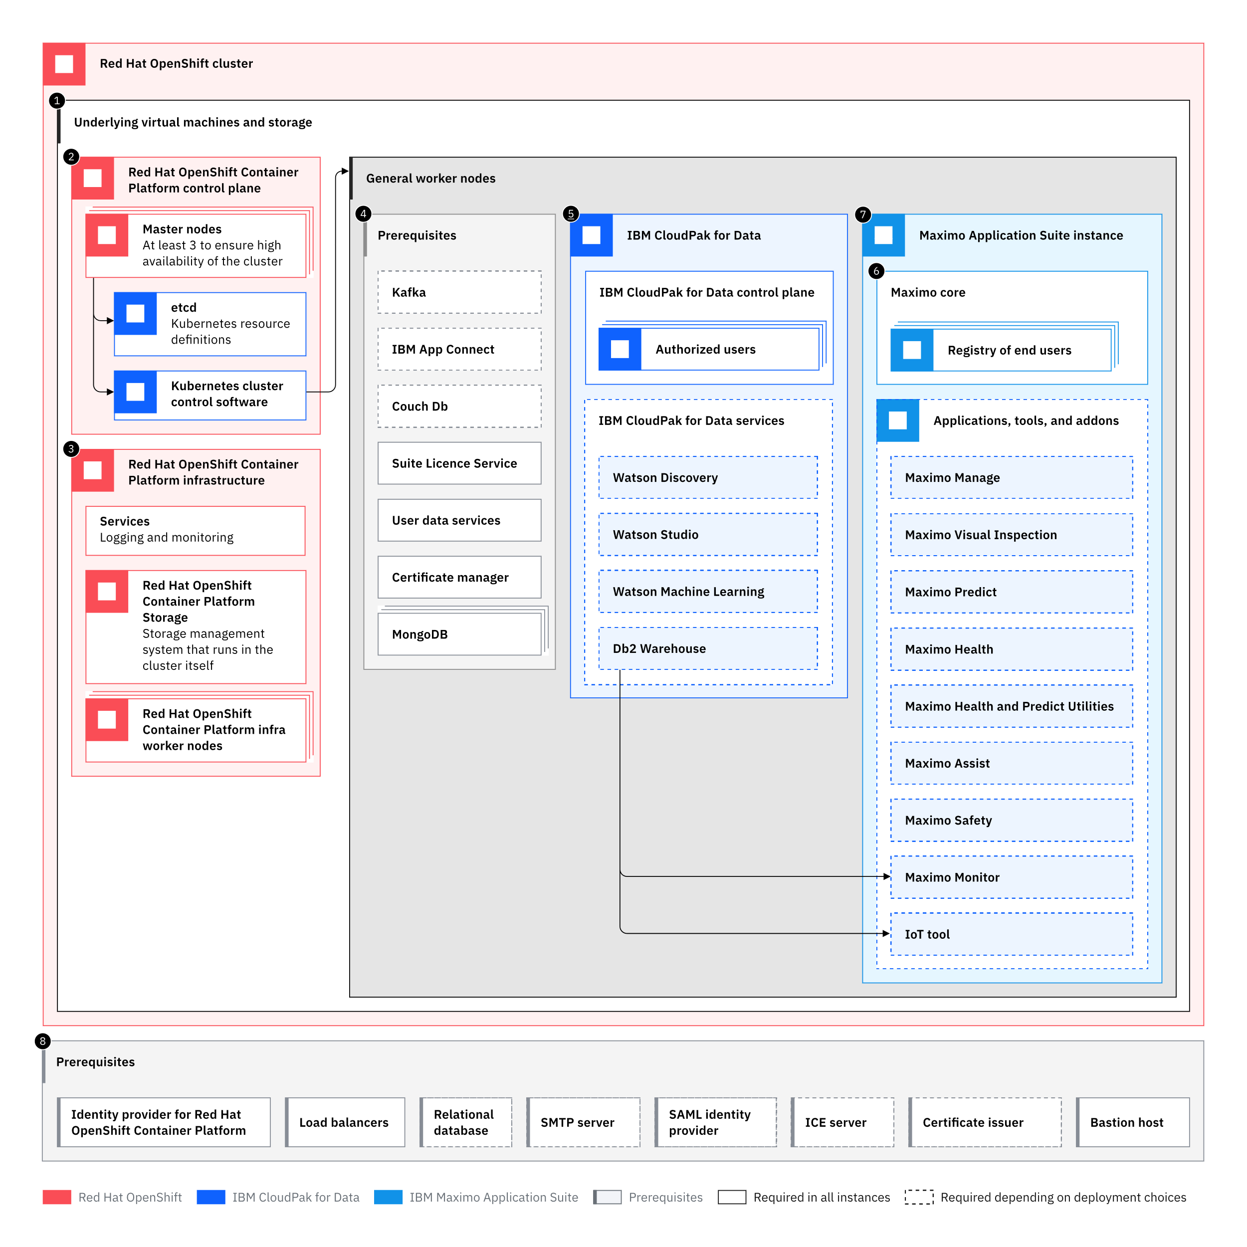
MAS Deployment on OpenShift – Typical Infrastructure Deployment Overview
Virtual Machines and Storage (IaaS, Paas such as ROKS)
RH OpenShift Container Platform Control Pane
RH OpenShift Container Platform Infrastructure
Maximo Application Suite Prerequisites
Cloud Pak for Data
MAS instance Suite Core
MAS Applications, industry solutions, addons and tools.

Slide 16
Dependencies of MAS Applications
Apart from Red hat OpenShift Platform as the dependency, MAS applications have dependency on other software.
Following table depicts the dependencies required for each of the four MAS applications.
# | MAS Applications | DB2 WH | Mongo DB | Apache Kafka
1 | IBM Maximo Manage | Required | Required | Required
2 | IBM Maximo Monitor | Required | Not Required | Not Required
3 | IBM Maximo Health | Required | Not Required | Not Required
4 | IBM Maximo Predict | Required | Not Required | Not Required
5 | IBM Maximo Visual Inspection* | Not Required | Not Required | Not Required
Note:
DB2 Warehouse is provided as part of the out of box license for MAS via Cloud Pak for Data.
It is recommended to have enterprise supported versions of Mongo DB and Apache Kafka for production set up.
Those two products are not included in the MAS license.
They can be hosted externally to OpenShift Platform as well.
* Maximo Visual Inspection uses a persistent volume claim (PVC) to manage storage

Slide 17
How To solution MAS Software based Deals
MAS Deployment - Solutioning Guide | IBM Confidential | IBM Cloud Solutioning Centers

Slide 18
1 Applications
Analysis of multiple custom applications developed:
Asstes
Planning
Preventive Maintenance
Inventory
Purchasing
Service Desk
Work Order
2 Customizations
MBO and field level classes
App and data beans
Integration / user exit classes
JSPs and custom images
Cron tasks
Automation scripting
Custom BIRT reports
Scope of the Technical Assessment for the EAM to Maximo Application Suite upgrade
5 Security
User life cycle
User management and security groups
Authentication
User synchronization
6 Architecture & Infrastructure
We took a look into the existing infrastructure, analyzed system context and interface diagrams
Communication protocols and
Network infrastructure
3 Integrations and Data Structure
3rd party integrations
Message queue systems
Database and data volume
Procedures and triggers on database level
4 EAM Add-Ons
Data management tool
Condition based monitoring
Drag and drop functioonality
Mobile application
Document scanner

Slide 19
MAS Dedicated Architecture Highlights
MAS Managed Services (MS) are required to have two (2) environments provisioned by default:
PROD and Non-PROD
All clients will be provisioned in their own application instance using dedicated namespace(s)
IT Administration for the PROD and NON-PROD environments is solely managed by IBM's MAS-Dedicated operations team
Clients can access PROD and NON-PROD systems via browser-based URL
MAS Dedicated is an internet-based offering that runs over HTTPS. There is no private cloud or direct connect option for MAS-Dedicated
Clients are provided application administrator access for all applications ordered
All servers are Red Hat Linux O/S
Maximo Manage databases are IBM DB2
Oracle and MS SQL Server are not supported
Reference: https://cloud.ibm.com/docs/mas-ms?topic=mas-ms-architecture#mas-dedicated-highlights

Slide 20
MAS Software Solutioning Aspects – Deployment Solution Scope
Client examples have the following key solutioning aspects:
MAS hosted on Single Zone Region or Multi Zone Region set up
A set of Microservices and Containerized Applications to host other components such as Portals, Integrations, etc.,
Selection of appropriate Storage and Database Services
Network to meet Connectivity and Security requirements
Access to other Cloud services (AppID, Key Protect, API Connect, etc.,)
Ensuring the Services used meets the Compliance requirements
Design to meet Availability requirements
Appropriate Cloud Support included in the solution.
Managed Services (Day 2 Management)

Slide 21
MAS - Sizing
IBM Technology tech sales or GSI Lab Subject Matter experts can provide the sizing for MAS components based on the client requirements.
The team mostly use the “IBM MAS Sizing Calculator” to produce sizing. CSC can use the sizing provided as an input to derive the OpenShift Cluster Architecture and Sizing.
Key Notes:
It is not clear if the sizing includes additional infrastructure required to implement HA for DB2 warehouse, Kafka and Mongo DB.
MAS provides a concept of Workspaces which can be utilized to provide multiple environments like more than one Dev, SIT or UAT environments. It is recommended to use separate OpenShift Cluster for Non-Production and Production.
MAS - Licensing
https://www.ibm.com/support/customer/csol/terms/?id=L-DPUD-5BMY6P&lc=en#detail-document

Slide 22
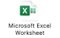
Estimation Calculation
https://www.ibm.com/support/pages/ibm-maximo-application-suite-870-system-requirements
Sizing Calculator

Slide 23
MAS License model – User has access to use all products in the level
Premium Concurrent User – 15 AppPoints
Manage Industry Solutions
Predict
Visual Inspection
Trans.
Nuclear
Utilities
Oil & Gas
Aviation
Civil Infras.
ACM
MSP
HS&E
Base Concurrent User – 10 AppPoints
Manage (full access)
Scheduler/Plus
Health
Spatial
Linear
Calibration
Limited Concurrent User – 5 AppPoints
Manage/Ind. Solutions (3 modules)
Manage Mobile user
(Anywhere/3rd party)
Monitor
Spatial
Linear
Calibration
Install – 1 AppPoint (x multiplier)
Manage ERP Adapter for SAP/Oracle (x80)
Manage
Spatial (x20)
Visual Inspection
(x45)

Slide 24
MAS - High Availability
HA for Application Binaries:
MAS components are built on OpenShift, and all the components are deployed as containers. There are no non-container-based components in MAS. Hence all the generic HA features of OpenShift based deployments can be applied to MAS installations.
HA for DB2 Warehouse:
Standard Edition of DB2 Warehouse is bundled with MAS license as part of Cloud Pak for Data entitlement. The database can be configured to run in HADR mode. The HADR is only supported in SMP (Symmetric Multiprocessor) Mode.
HA for Mongo DB:
MAS supports Mongo DB community Edition. A replica set (not same as Kubernates replica set) in MongoDB is a group of mongod processes that maintain the same data set. Replica sets provide redundancy and high availability and are the basis for all production deployments. A typical Mongo DB replica set consists of one Primary and two secondary mongod processes (3 node set up)
HA for Apache Kafka:
MAS supports opensource Strimzi version of Apache Kafka. However, it need not be deployed along with other MAS components. An external Apache Kafka implementation such as IBM Event Streams, RedHat AMQ Streams, Amazon Managed Streaming for Apache Kafka, etc.,. Depending on the requirements of the client, high availability for components of Apache Kafka can be set up as per the product offering.

Slide 25
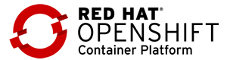
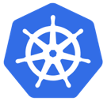

High Availability for DB2 Warehouse – A Client Example
A 3 node based SMP DB2 WH HADR set up is proposed.
Production cluster will have two instances of DB2 WH set up with HADR using NEARSYNC replication mode.
This will have one node as primary and another one as principal standby. This setup supports auto failover.
DR cluster will have another standby as auxiliary via SUPERASYNC mode replication.
With this set up there is HA in production and as well as it provides replication to DR with no impact to performance of the system.
Prod Cluster
DR Cluster
Auto Failover
Manual Failover
DB2 WH Pod 1 in SMP (Principal Standby)
DB2 Wh Pod 2 in SMP Mode (Primary)
DB2 WH Pod 1 in SMP (Auxiliary Standby)
HADR (NEARSYNC replication)
HADR
(SUPERASYNC replication)
Worker Node1
Worker Node2
Worker Node1
VM
VM
VM
Hypervisor
Hypervisor

Slide 26
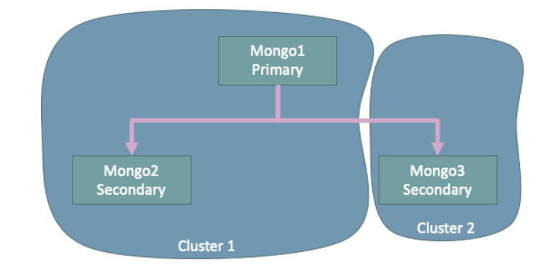
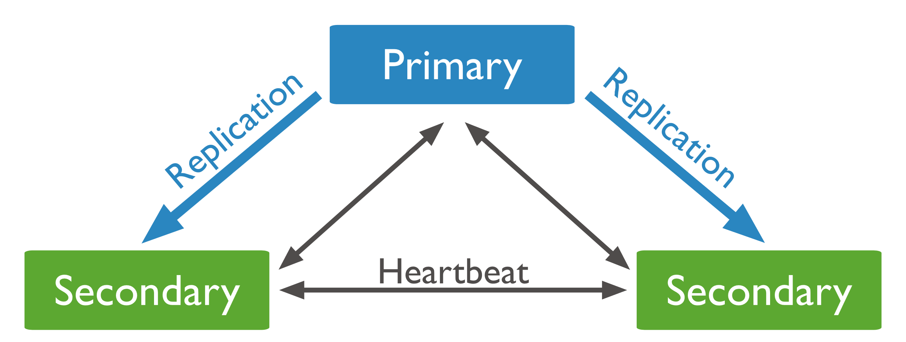
High Availability for Mongo DB – An Example
Similar to DB2 HADR, Mongo DB can also be set up with a 3 node/replica set architecture across 2 OpenShift clusters.
If the current primary node suddenly becomes unavailable, an election will take place to determine the new primary node. In the scenario of having two secondary nodes, one of the secondary nodes will become the primary node
A sample way to set up is provided in this article (https://medium.com/ibm-garage/how-to-implement-mongodb-replication-across-multiple-openshift-clusters-81c216967809 )

Slide 27
MAS - DevOps Process
You can move user interface components and applications across servers, for example to move from a nonproduction environment to a production environment. Different members of the organization can configure different applications and then move them to a centralized test environment.
Maximo Manage provides an inbuilt tool to manage the DevOps. Further info is available at (https://www.ibm.com/docs/en/maximo-manage/8.2.0?topic=controls-moving-components-applications-across-servers )

Slide 28
MAS - Backup, Recovery, Monitoring, and Disaster Recovery
MAS backup covers 3 areas: Backup & DR info https://cloud.ibm.com/docs/mas-ms?topic=mas-ms-backups-and-disaster-recovery
Application Backups
System Configuration Backups
Database Backup and Retention
In the event of a DR issue with the MAS Dedicated Service offering for a specific customer, IBM's focus will be in the following order:
Recover the existing infrastructure in place
Recover within the same IBM Cloud data center to a new infrastructure
Recover to a secondary IBM Cloud data center
In the event a disaster is declared, the base parameters are Service Level Objectives (SLO's) and not Service Level Agreements :
Recovery Time Objective (RTO) - 72 hours Recovery Point Objective (RPO) - 24 hours
RTO is the longest possible time needed to make the application available. RPO is the longest possible time since data was last backed up.
Prometheus is the intended target for all metrics that MAS and MAS applications should produce. OCP 4.6 onwards offers user workload monitoring using dedicated Prometheus installation.
Each of the applications in MAS have their own metrics published to Prometheus.
For example, Maximo Manage documentation can be found here (https://www.ibm.com/docs/en/maximo-manage/8.2.0?topic=deploy-monitoring-agent-maximo-manage )

Slide 29
MAS Hardware BOM - Typical Example
P2 – Solution and Architecture Detail
Environments:
Production and DR – 72 VPC, 368 GB RAM
Non Production (Individual) – 53 VPC, 210 GB RAM
An additional worker node of 16 VPC is added for additional DB2 WH standby node.

Slide 30
Architectural Decisions (MAS )
AD | Topic | Alternatives | Decision & Motivation
AD #1 | Hosting Location | Public Clouds On Premises Data centers Distributed Cloud such as Satellite | Public Cloud | Quick GTM Strategy Opex based on operations rather than Capex Flexible options (IaaS, PaaS) for middleware such as databases and Kafka Client preference
 |  |  | On Premises Data Centers | Regulations and Data Residency influence Client’s sunk investment Other components of the solution exist in DC.
 |  |  | Distributed Cloud such as Satellite | Client gets best of the public cloud like services and still meet data residency or regulatory requirements by subscribing to offerings such as IBM Cloud Satellite.
AD #2 | OpenShift Offering | Managed OCP Offerings (ROKS, ROSA, ARO) Bespoke OCP Install | Though with the use of managed OCP offerings there would be reduced complexities for managed services, MAS provides a built in OCP subscription. We do not have a certified solution on such Managed OCP Offerings on ARO/ROSA. MAS also requires a specific version of OCP, which may not be available in such offerings. Recommend reviewing these aspects & choose best fit for client needs.
AD #3 | OpenShift Clusters | Separate OCP Cluster for Production and Non-Production Single OCP Cluster for all environments | Though MAS provides a concept of workspaces which can provide the isolation levels between production and other environment, it is recommended to go with dedicated cluster for Production. A separate cluster also helps in testing upgrades before deploying to production.
AD #4 | OpenShift Worker Nodes | Separate | Leveraging separate OCP worker nodes for database. In prod and DR, the workload can be extensive and separating worker nodes for DB and MAS core can help in isolation of resources and thus de-risking
Notes:
Hosting Options
As the MAS is built on OpenShift, the choice of hosting location is dependent on client’s overall needs. It is recommended to use public clouds if IBM has the liberty to choose a hosting location and always start with IBM Cloud Offerings.
Storage
Maximo requires “ReadWriteOnce”. With this requirement any block storage or file storage can be used. SDS solutions such as ODF may be explored if there is a need for stringent HA requirements with SLAs.

Slide 31
Architectural Decisions (MAS )
AD | Topic | Alternatives | Decision & Motivation
AD #5 | Storage Options | NFS SDS Standard Public Cloud Storage Options | NFS | Client already using NFS store on-prem other hyperscalers
 |  |  | SDS | Client is using some form of Software Defined Storage
 |  |  | Standard Public Cloud Storage | Client is comfortable using COS
Maximo requires ReadWriteOnce (RWO)
Stringent HA reqmnt w/ SLAs
Y
ODF
Y
SDS
3 OCP nodes will run ODF services & each has:16 core / 64 GB memory
N
N
NFS
Y
Portworx
N
Client probably using Azure or AWS
Expensive option used on dedicated instances
Cloud Store
Notes:
Hosting Options
As the MAS is built on OpenShift, the choice of hosting location is dependent on client’s overall needs. It is recommended to use public clouds if IBM has the liberty to choose a hosting location and always start with IBM Cloud Offerings.
Storage
Maximo requires “ReadWriteOnce”. With this requirement any block storage or file storage can be used. SDS solutions such as ODF may be explored if there is a need for stringent HA requirements with SLAs.

Slide 32
Architectural Decisions (MAS )
AD | Topic | Alternatives | Decision & Motivation
AD #6 | Choice of SQL Database | IBM Db2 IBM Db2 Warehouse Oracle MS SQL Server | IBM Db2 | Supported by MAS. Depends on client requirement.
 |  |  | IBM Db2 Warehouse | MAS license comes bundled with Db2 Warehouse
 |  |  | Oracle | Supported by MAS. Depends on client requirement.
 |  |  | MS SQL Server | Supported by MAS. Depends on client requirement.
AD #7 | Mongo DB Options | Community Edition PaaS Offering on Public Cloud Client provided Mongo DB services | Community Edition | Supported by MAS. Recommend using Enterprise Edition in production.
 |  |  | PaaS offering on Public Cloud | Supported by MAS. Depends on client requirement.
 |  |  | Client provided Mongo DB services | Supported by MAS. Depends on client requirement.
AD #8 | Apache Kafka Options | Strimzi Opensource Edition PaaS Offering on Public Clouds Client provided Kafka Services IBM Event Streams Red Hat AMQ | Strimzi Opensource edition | Supported by MAS. Recommend using Enterprise Edition in production.
 |  |  | PaaS offering on Public Cloud | Supported by MAS. Depends on client requirement & IBM scope of work.
 |  |  | Client provided Kafka services | Supported by MAS. Depends on client requirement & IBM scope of work.
 |  |  | IBM Event Streams | Supported by MAS. Depends on client requirement & IBM scope of work.
 |  |  | Red Hat AMQ | Supported by MAS. Depends on client requirement & IBM scope of work.

Slide 33
Moving from Maximo 7.x to MAS 8.x
MAS Deployment - Solutioning Guide | IBM Confidential | IBM Cloud Solutioning Centers

Slide 34
Moving from Maximo 7.x to MAS 8.x
Moving to MAS 8.x is both an upgrade and migration when using MAS Dedicated or MAS SaaS
It is a 2-step process
Upgrade current Maximo version to 7.6.1.2
Migrate Maximo to Maximo Application Suite v8.x
Two approaches
Lift and Shift (most popular)
Re-implement
View documentation here
https://www.ibm.com/docs/en/maximo-manage/continuous-delivery?topic=upgrading-from-maximo-enterprise-asset-management-maximo-manage
IBM has officially announced End of Service for Maximo 7.6.1.2 on September 30, 2025.

Slide 35
Oracle to DB2 Migration Solution Scope Summary
Oracle to DB2 Solution Scope will be for all data elements within Maximo for all business functions at client.
Migration will happen in three parts:
Extract of Data from Oracle Database in Flat File Format
Execution of Conversion scripts to translate Oracle format to DB2 SQL Format
Load of DB2 SQL formatted data into Maximo DB2 Database
Oracle DB
Oracle
Flat Files
DB2
SQL Files
DB2 DB
Extract
Translate
Load

Slide 36
Journey to MAS SaaS or MAS Dedicated
Begin
Complete
Maximo EAM
Maximo Application Suite
Planning
Initial Set Up
and preconditions
Test 1
Test 2
Live on MAS
Post Live MAS activities
Project Planning
Budget
Approvals
Timeframes
requirements definition
Quotes and any additional contracts required
Deploy MAS Dedicated or SaaS and applications
Remediate changes as required
Setup integrations including any VPN
Preconditions met
Migrate database
Upgrade to latest version
Finish remediation of changes needed
Repeat the process of upgrading and migrating database
Test as required
Take accurate timings of steps for Production cutover
Also known as the dry run or dress rehearsal
Cutover production weekend
Backflow to non-production instances
Hypercare for 1 week after cutover

Slide 37
Self-managing MAS 8.x on-premises: What customers should know
Products Skills | Infrastructure Size | Time Investment | Alternative
Red Hat OpenShift IBM Cloud Pak 4 Data | MAS 8 on OpenShift requires a larger server deployment | Is it worth hiring or training additional staff to administer and maintain the environment? | IBM can provide on prem platform services to deploy and manage OpenShift
Questions to ask
Is my team able to justify training or hiring someone to manage the new MAS architecture?
Will we be able to maintain the quality of service that users expect if we maintain the application on-premises?
Is it more cost-effective to purchase physical hardware, utilize cloud services, or opt for a fully-managed solution?
Do my organization’s security policies permit MAS to be deployed to the cloud? Are FedRAMP or other security standards required?
How much control of security and access policies is my organization willing to trust to a managed service provider (MSP)?

Slide 38
IBM MAS managed services: What customers should know
Direct database access to production databases is not permitted, even in a read-only capacity.
If database access is required, you must provision an additional reporting server. You’ll need this if you plan to connect an external dashboarding tool, such as Tableau or IBM Cognos Cloud. You’ll also need it to query production data, such as while troubleshooting an application issue.
Only DB2 database platform is supported.
If you are currently using SQL Server or Oracle, you will be responsible for converting the database to DB2 before migrating to IBM Managed Services.
Java customization is not permitted.
Any current Java customizations must first be converted to automation scripts or another supported configuration option
Third-party tools with server-side installs, such as SRO Data Replication, are not permitted in the IBM cloud.
If you are using a third-party application, it must reside on-premises or in a non-IBM cloud (e.g., AWS), where it may be integrated with Maximo.

Slide 39
RACI / ROI
MAS Deployment - Solutioning Guide | IBM Confidential | IBM Cloud Solutioning Centers

Slide 40
High Level RACI – Typical Example
 | IBM Consulting |  |  |  | IBM Technology |  | CLIENT
High Level Scope | IBM Consulting | PMO team | DevSecOps | PES | Product | Expert Lab
MAS License Subscriptions | A,C |  |  | C,I | R | C | I
MAS product sizing and design | A,C |  |  | C,I |  | R | I
MAS Installation on Red hat OpenShift | A,C |  |  | C,I |  | R | I
MAS configuring monitoring management & DR aspects | A,C |  |  | C,I |  | R | I
MAS monitoring and maintenance | A,C |  | R | C |  | C | I
OpenShift Design and Build | A,R |  |  | R |  | C | I
OpenShift Managed Services | A,C |  | C | R |  | C | I
MAS Monitoring Configurations | A,C |  | R | C |  | C | I
Infrastructure, Hypervisor, Storage, Security, Networking | A,C |  |  | R |  |  | R
Above RACI assumes that IBM is responsible for design, build and manage the entire platform.
Underlying Infrastructure can be managed by Client if its an On Premise solution. If it is public cloud, PES can provide the services as well.

Slide 41
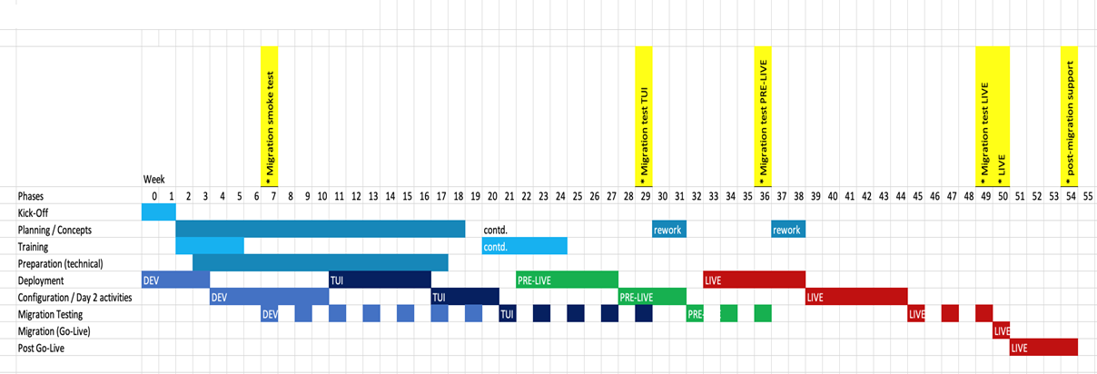
High-Level Project Plan and Timeline
Initial phase with concepts and setting up a development environment
First, set up a system for development purposes and testing (DEV1)
Enables developing of operational concepts
Followed by setting up TUI

Slide 42
Sample SLA / SLO - RFP
Service Conditions | Description
SLA for Support Services | 90% of P1 incidents will achieve a response time within 15 minutes and be resolved within 24 hours, 100% within 7 days. P1 incidents are worked continuously 24/7. 90% of P2 incidents will achieve a response time within 30 minutes and be resolved within 48 hours, 100% within 7 days. P2 incidents are worked continuously during business hours. 90% of P1 and P2 incidents will have root cause analysis (RCA) completed within 10 business days 90% of changes successfully completed on approved change schedule
SLO for Support Services | 90% of P3 incidents will be resolved within 10 calendar days 98% of P3 incidents are resolved within 14 calendar days following initial notification 90% of P4 incidents are resolved within 120 days 99% of P3 and P4 incidents closed within 90 days 90% of ticket type required or catalog tasks closed within 90 days 90% of problem records closed within 120 days
SLA for Application Availability | Production availability to be determined based on supplier capability but shall be greater than or equal to 99.9%. These are proposed for your consideration as a minimum requirement. Please propose measures that are like or better.
SLA for Application Response Time | 95% of successful application transactions completed in 2.0 seconds. These are proposed for your consideration as a minimum requirement. Please propose measures that are like or better.
Recovery Time Objective (RTO) Recovery Point Objective (RPO) | RTO of less than 4 hours RPO measured from the last logged successfully completed transaction

Slide 43
ROI Considerations
When comparing options, costs must be calculated to several components:
MAS Dedicated and MAS SaaS offers more than just the infrastructure and to understand the ROI, all categories must be considered.
Category | Client Managed | MAS Dedicated | MAS SaaS
Infrastructure | Client | Included | Included
MAS Entitlement | Client | Client | Included
Supporting Software | Client | Included | Included
System Admins | Client | Included | Included
Database Admins | Client | Included | Included
Network Admins | Client | Included | Included
Security Admins | Client | Included | Included

Slide 44
ROI Example – Clients buying MAS Dedicated
 | IBM Pricing |  | Client Costs
 | IBM MAS Dedicated | MAS Software (Only for Dedicated) – 50 authorized users | MAS Software | Infrastructure | Operational Software | Client – Personnel – Install and setup | Client – Personnel – Ongoing operations | Total Client Costs
1) Common Comparison – compare IaaS | $157,000 | $200,000 | $200,000 | $63,000 |  |  |  | $63,000
2) Compare to PaaS | $157,000 | $200,000 | $200,000 | $63,000 | $19,200 | $32,000 |  | $82,800 plus one time $32,000
3) Compare to IBM offerings | $157,000 | $200,000 | $200,000 | $63,000 | $19,200 | $32,000 | $140,000 | $222,000 plus one time $32,000
Scenario 1 – client costs only looks at infrastructure – misses costs for all other services needed to operate MAS
Scenario 2 – includes the installation and some of the software, but misses the ongoing operational cost of people
Scenario 3 – the apple to apple comparison

Slide 45
MAS References
MAS Deployment - Solutioning Guide | IBM Confidential | IBM Cloud Solutioning Centers

Slide 46
IKEA
IBM Cloud

Slide 47
Context and objective
IKEA has been using Maximo Application suite hosted on IBM cloud for 10 years
Currently the client has requested options to reduce costs for hosting and managing the Maximo solution
IBM consulting owns the cloud account and have previously sub-contracted Kyndryl to provide managed platform service
Proposed to migrate customer from Maximo 7.6.12 to MAS 8.x dedicated
IBM AMS Maximo CoC will convert existing Java customizations to automation scripts

Slide 48
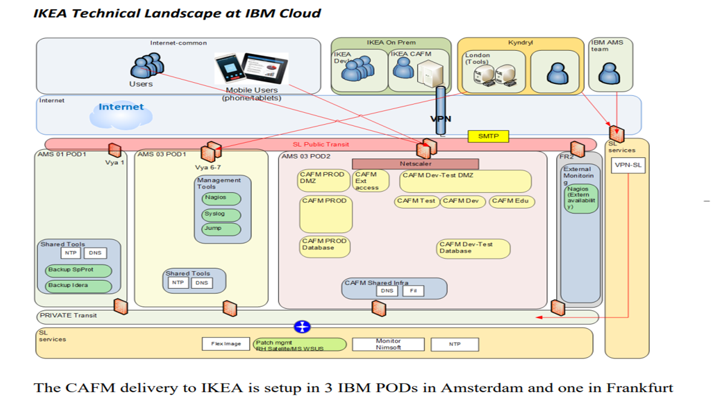
IBM Deployment: MAS 7.6

Slide 49
Florida Power & Light (FPL)
AWS

Slide 50
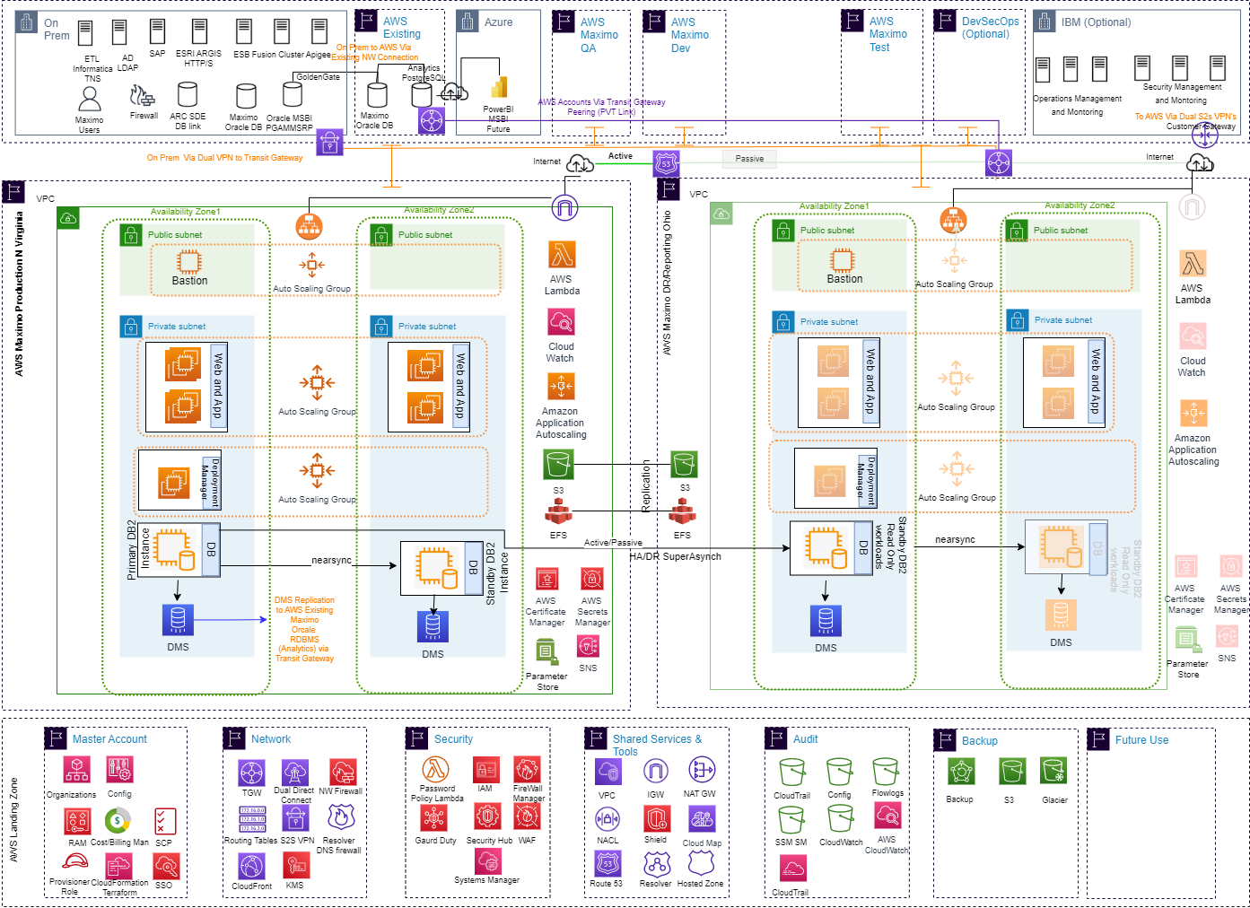
AWS Deployment: MAS 7.6

Slide 51
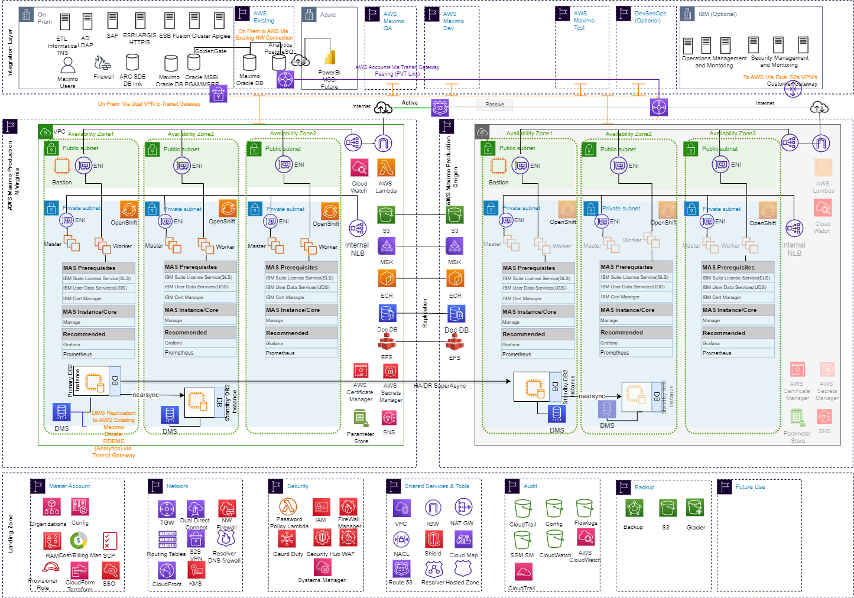
AWS Deployment: MAS 8.x

Slide 52
AWS: MAS SaaS
MAS SaaS offering on AWS have 2 subscription options:
* MAS Manage Authorized provides entitlement for up to 25 Limited Authorized users. * MAS Manage Concurrent provides entitlement for up to 10 Limited Concurrent users.
Units | Description | 12 Months
MAS Managed Authorized | MAS SaaS Manage – up to 25 limited authorized users | $49,950
MAS Managed Concurrent | MAS SaaS Manage – up to 10 limited authorized users | $49,950

Slide 53
Bruce Power
Azure

Slide 54
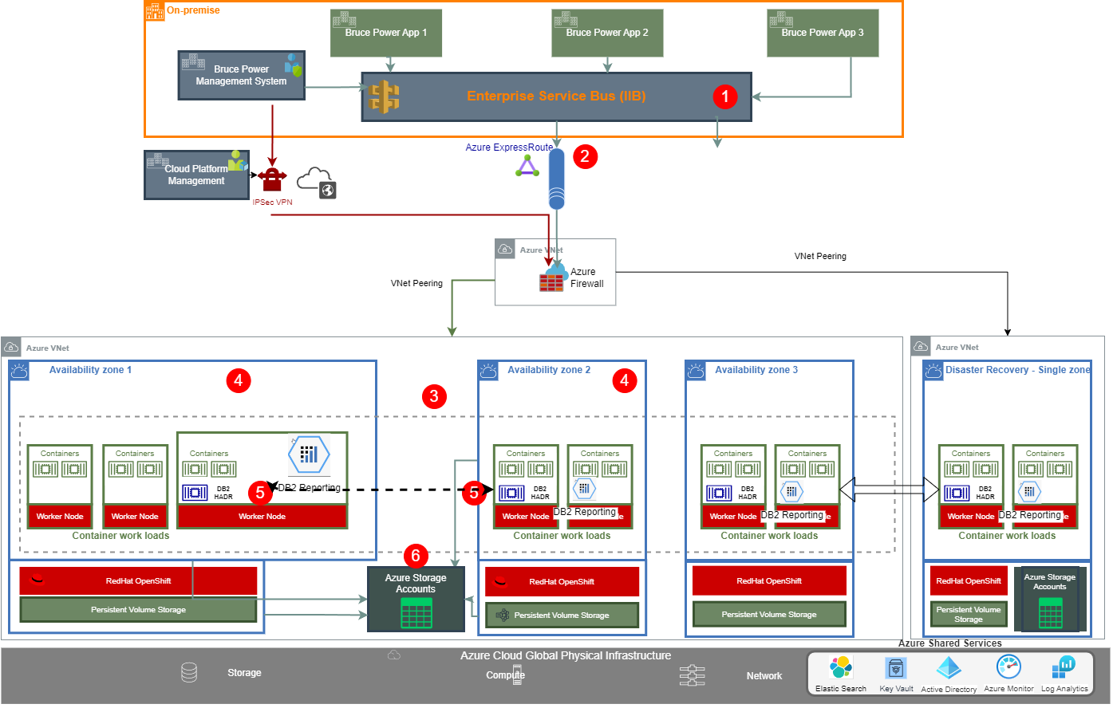
Azure Solution Design - Architecture Overview
Key Design / Architecture Info
Existing ESB (IIB) Stay on-premises and MAS on Azure Cloud
Utilize Azure ExpressRoute to provide reliable, fast, and secure communication between on-premise and MAS
HA design of MAS with workloads distributed across 3 availability zones
HA OpenShift Cluster with VM nodes in 3 zones and HA DB solution with Zone Redundant (ZRS) Storage
Cloud Pak for Data DB2 instance established as DB2 HADR configuration
Zone Redundant Azure Storage Accounts for HA (High Durability and Resiliency)
Disaster Recovery (DR) design with the deployment of MAS, OpenShift and DB2 Storage in Azure Primary Region (Canada Central) and DR region (Canada East)
End to End HADR and Resiliency design from network to application container work load to Storage.
1
2
3
4
5
6
7
8

Slide 55
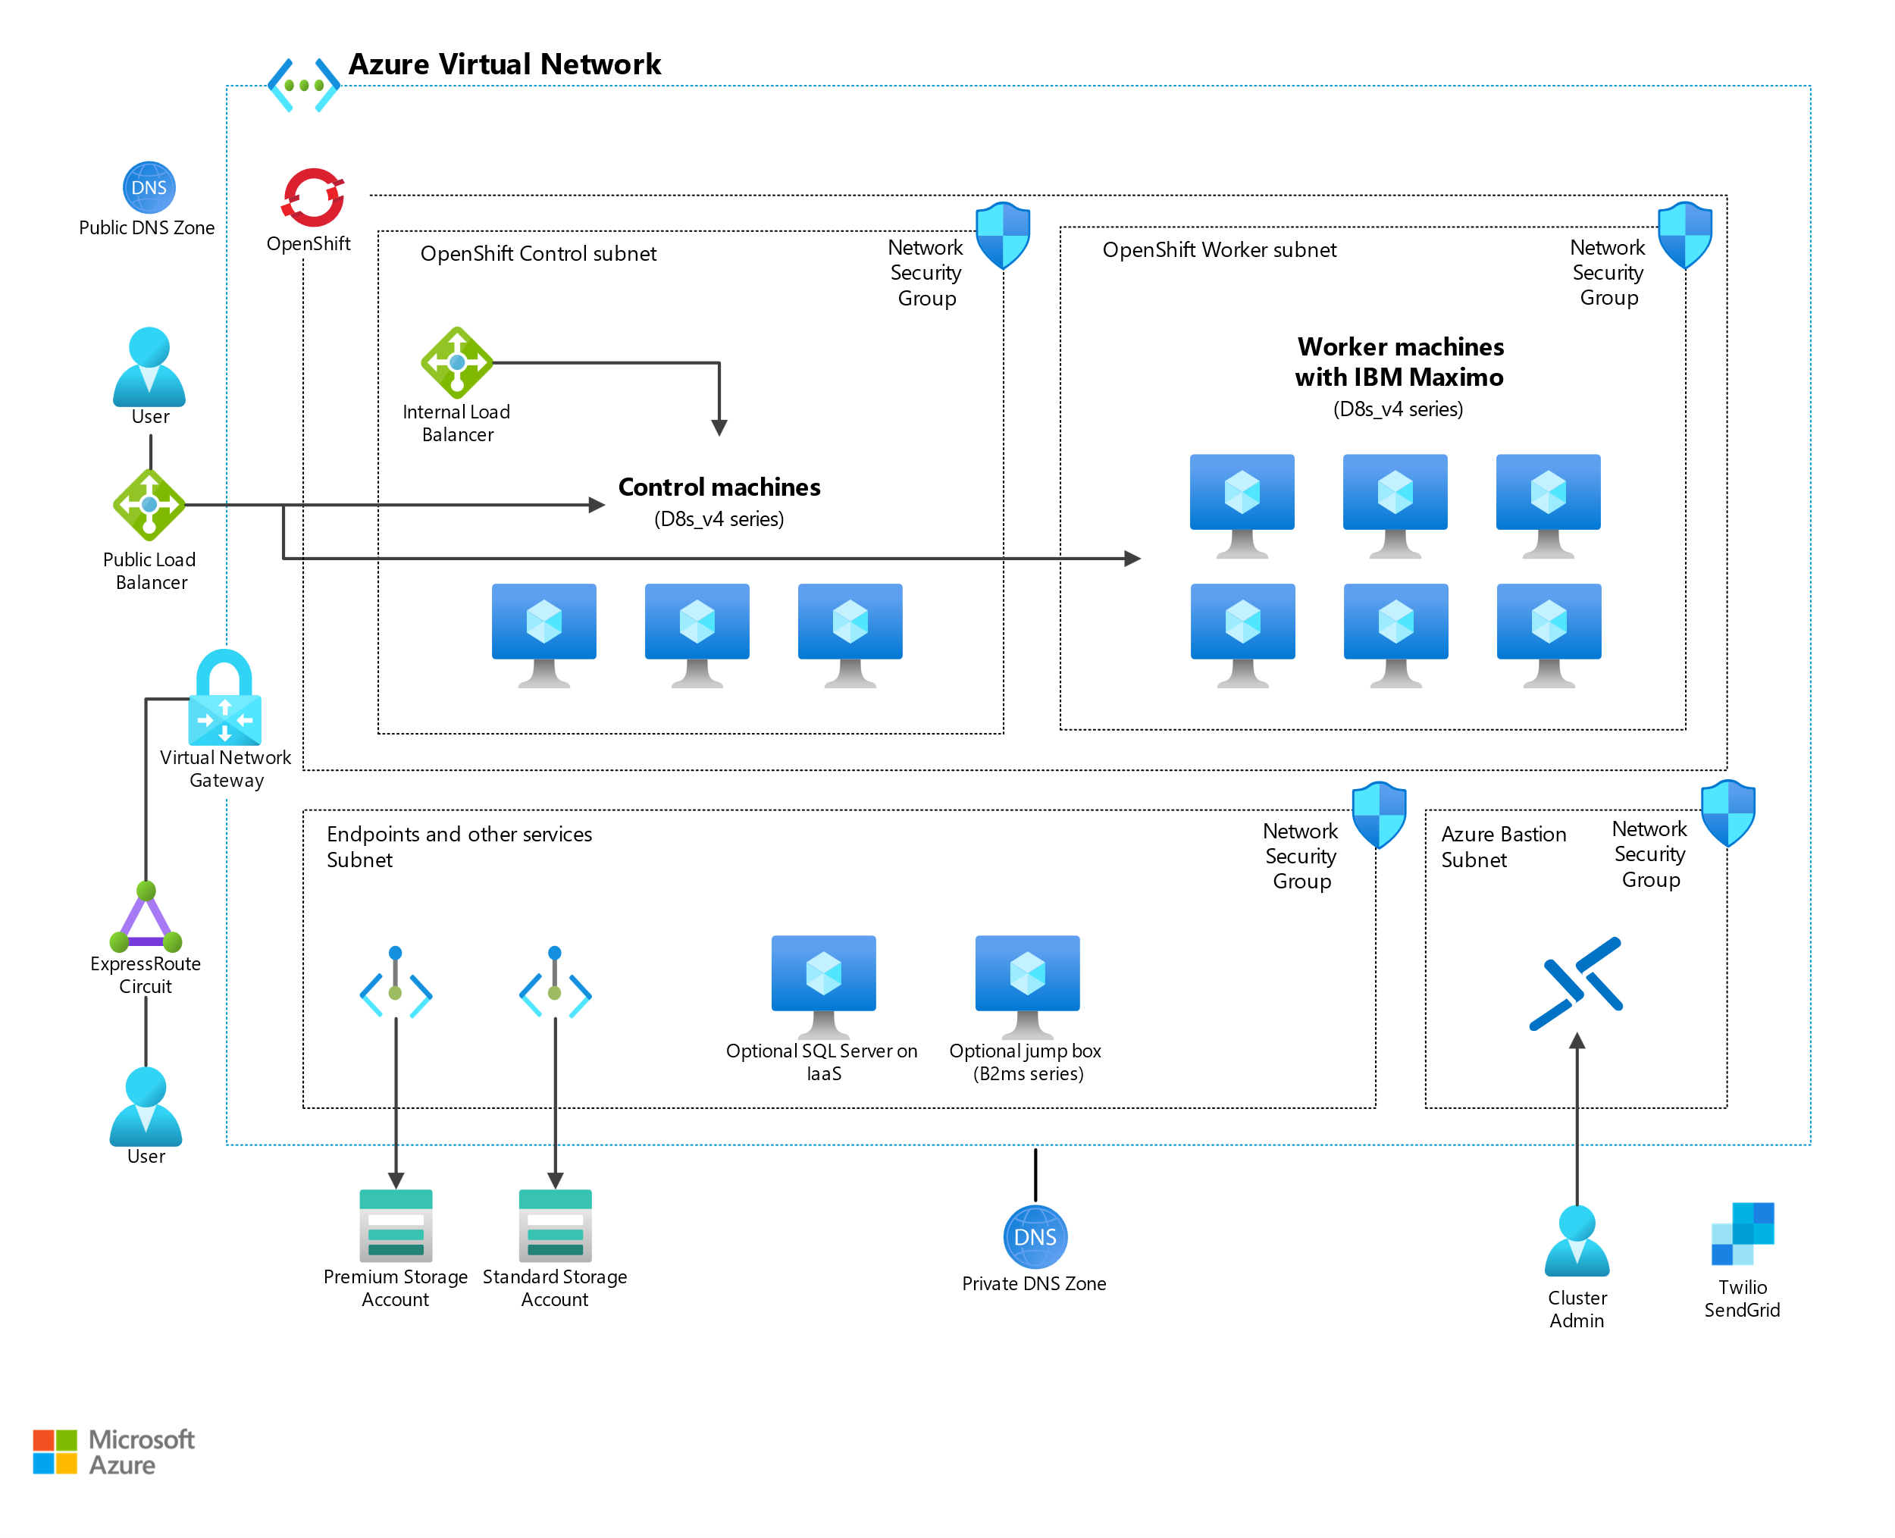
Azure: MAS 8.x Deployment
A container hosting platform to deploy highly available workloads across availability zones
A privatized deployment of worker and control nodes that are integrated with storage
Azure Premium Files and standard files for storage (OpenShift Data Foundation not required)
SQL Server on Azure VMs or container-based IBM Db2 Warehouse
Azure DNS for DNS management of OpenShift and its containers
Azure Active Directory (Azure AD) for single sign-on into MAS
SQL Server on Azure Virtual Machines (optional) SQL Server on Azure Virtual Machines (VMs) to provide data services to MAS. The database can also be another, like Oracle Exadata or IBM Db2 Warehouse. Azure SQL Database and Azure SQL Managed Instance aren't supported right now.
We recommend installing the latest stable version of MAS because it provides the best integration options with Azure. Pay close attention to the versions of OpenShift that are supported, because the supported versions vary with the specific version of MAS.
Currently the sliding window release cycle of Azure Red Hat OpenShift is too frequent for it to be supported by IBM Maximo Application Suite.
Notes:
Source: https://learn.microsoft.com/en-us/azure/architecture/example-scenario/apps/deploy-ibm-maximo-application-suite

Slide 56
Azure: MAS Architecture Decisions
AD # | Requirement | Alternatives | Component Decision | Reason
1 | Data
1.d | Databases | Oracle on Azure VM DB2 DWH Containers on OCP cluster SQL Server on Azure VM DB2 On Azure VM | DB2 DWH Containers on OCP cluster | DB2 DWH Containers is the MAS On Azure tested solution. Other solutions are the supported options, however not tested by Maximo product team
1.e | Reporting and Visualization
2 | Compute
2.d | Containers | Azure Kubernetes Services Azure RedHat OpenShift(ARO) RedHat OpenShift On Azure VM (self managed) | RedHat OpenShift On Azure VM (self managed) | RedHat OpenShift on Azure VM (Self Managed) is a tested solution MAS does not support ARO or AKS container orchestration
3 | Storage
3.a | Primary | Azure Storage Portworx ODF | Azure Storage | Azure Storage option has been tested and validated for performance and reliability. Azure ZRS provides HA for the storage ODF and Portworx are supported options, not validated by Maximo Product team
3.c | Backup | Azure Backup | Azure Backup | Azure backup provides option for DR in the 2nd region

Slide 57
Azure: MAS Architecture Decisions (cont.)
AD # | Requirement | Alternatives | Component Decision | Reason
4 | Networking
4.a | Enterprise Connectivity | VPN Gateway ExpressRoute | Azure ExpressRoute | Provides private connection (through a connection provider) does not expose network traffic to the public network Preferred option over VPN Gateway for regulated workloads with strict network isolation requirements.
4.b | Segmentation | VNets Subnets NSGs VNet Peering | VNets, subnets, NSGs | Azure Vnets provides secure isolated virtual networks. Communication between resources is over a private network Subents provides another layer of segmentation to separate OpenShift control pane and Worker nodes NSG (Network Security Groups) provide fine grained control over the traffic between subnets VNet peering enables hub and spoke model, hub VNet is peered with workload Vnets.

Slide 58
Azure: MAS Architecture Decisions (cont.)
AD # | Requirement | Alternatives | Component Decision | Reason
4.c | Cloud Connectivity | IBM Cloud Service Endpoints Public network endpoints | IBM Cloud Service Endpoints | Keeps communication between apps and cloud services within private network
4e | Load Balancing | Azure Internal Load Balancer | Azure Internal Load Balancer | The Internal Load Balancer distributes traffic among the worker nodes across the zones.
4.g | Domain Network Services (DNS) | Azure DNS | Azure DNS
5 | Security
5.a | Data Security
5.b | Identity and Access Management
5.c | Application Security
5.d | Infrastructure and Endpoint
5.e | Threat Detection and Response
5.f | Security Operations: Key Lifecycle Management
6 | Resiliency
6.A | Backup
6.c | High Availability | Availability Sets Availability Zones | Availability Zones | 3 AZs are available in Central and East Region Workloads can be distributed across zone to provide 99.9% availability Availability Sets provide availability in the zone with one or more fault domains, risk of zone failure is not addressed
Notes:
Owner : CSC

Slide 59
Supporting Information & FAQs
MAS Deployment - Solutioning Guide | IBM Confidential | IBM Cloud Solutioning Centers

Slide 60
Reference Links
Maximo IBM Documentation
Maximo Sizing Calculator
Maximo Managed Services Offering Documentation
Maximo Playbook
Customer references in seismic
https://ibm.seismic.com/Link/Content/DCqgjPqQqF6CB89XHQW9MQBMVDP3
MAS docs
https://www.ibm.com/docs/en/maximo-manage/continuous-delivery?topic=upgrading-from-maximo-enterprise-asset-management-maximo-manage
Migration Considerations
https://www.mavenasset.com/move-forward-to-mas/
https://www.ibm.com/docs/en/maximo-manage/continuous-delivery?topic=upgrading-from-maximo-enterprise-asset-management-maximo-manage

Slide 61
FAQs
Do you have any customer references?
https://ibm.seismic.com/Link/Content/DCqgjPqQqF6CB89XHQW9MQBMVDP3
We are currently using Maximo 7.2. Can we continue using it?
IBM has officially announced End of Service for Maximo 7.6.1.2 on September 30, 2025.
You will have to upgrade to Maximo 7.6.1.2 and then move over to Maximo Application Suite 8.x.
What is MAS?
Previously known as Maximo® Enterprise Asset Management (EAM), Maximo Manage is part of IBM® Maximo Application Suite (MAS) and has enhanced plus new features.
Maximo Asset Management 7.6.0.10 or 7.6.1.2 or later is required before you upgrade to Maximo Manage.
How long does it take to move from Maximo 7.x to MAS 8.x?
It depends but roughly anywhere from x to y weeks
https://www.mavenasset.com/move-forward-to-mas/
Does MAS only run in the cloud?
No, MAS can also be installed on-premises.
Is MAS supported on all hyperscalers?
MAS runs on IBM Cloud, AWS, Azure

Slide 62
Thank You
MAS Deployment - Solutioning Guide | IBM Confidential | IBM Cloud Solutioning Centers

